Slide 1
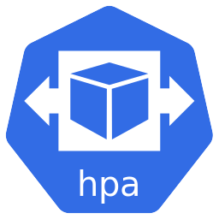





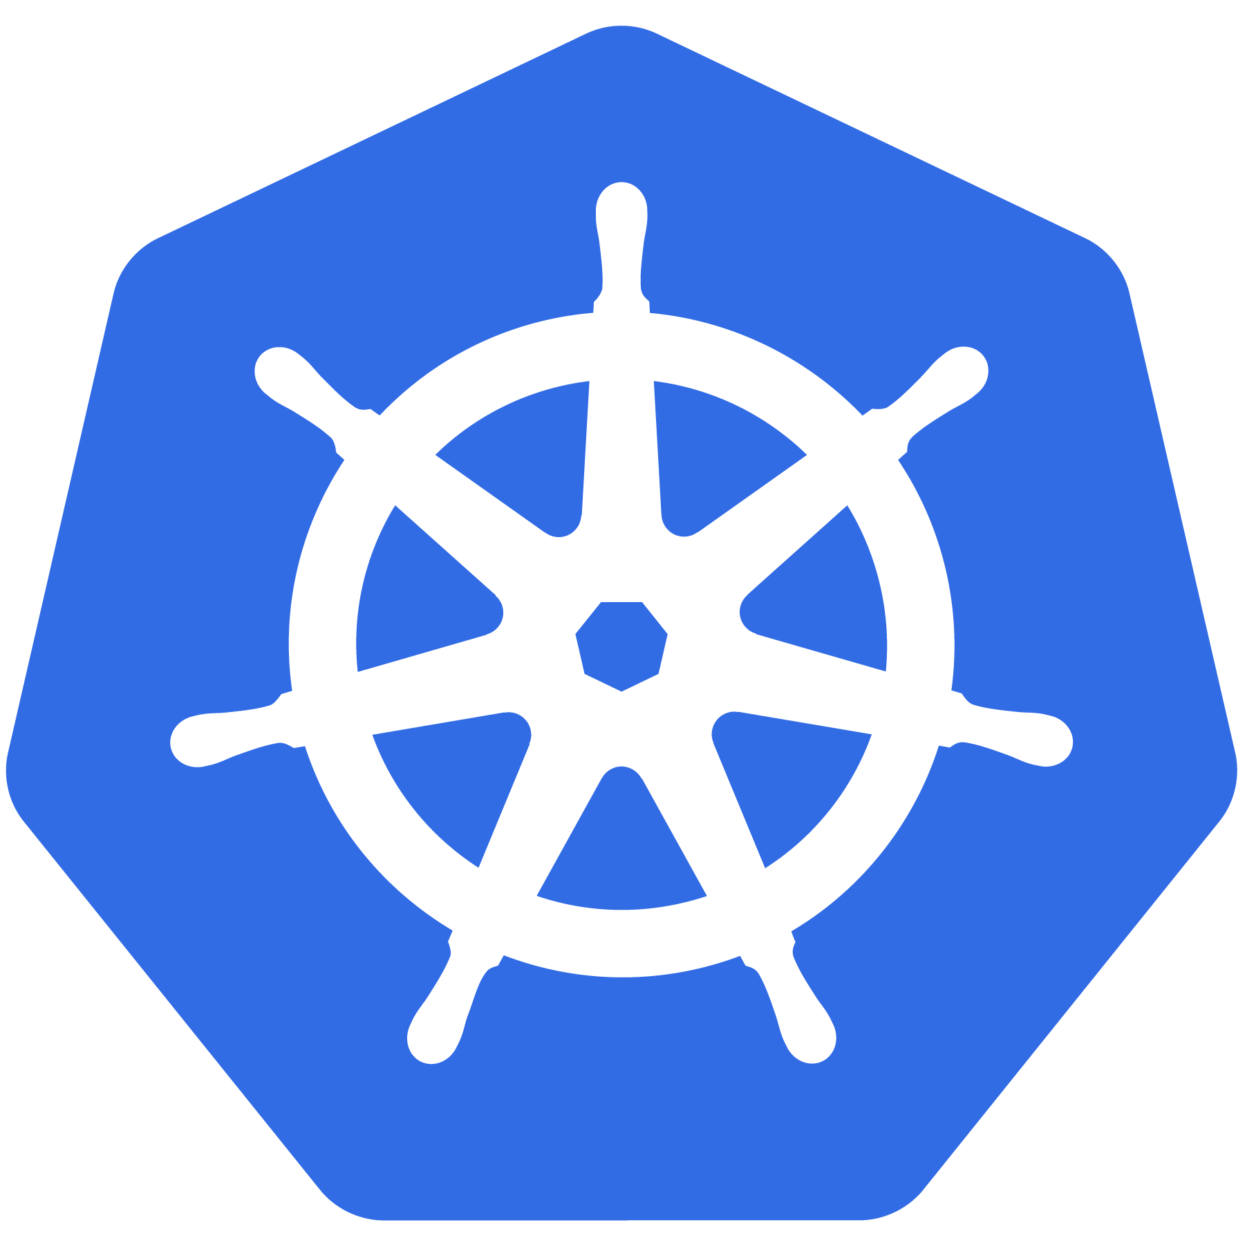
Kubernetes
Autoscaling, Monitoring & Logging

Slide 2
Agenda
Metric Aggregation
Autoscaling
HPA
Cluster Autoscaler
Monitoring
Prometheus
Log Management
EFK Stack

Slide 3
Before Autoscaling..
We Need Metrics !

Slide 4
Metrics API Server
Metric server collects metrics such as CPU and Memory by each pod and node from the Summary API, exposed by Kubelet on each node.
Metrics will be aggregated, stored in memory
Used by Kubernetes components HPA, scheduler, kubectl top,

Slide 5
Horizontal Pod Autoscaler
Scales the number of pods in a replication controller, deployment, replica set or stateful set
Periodically adjusts the number of replicas to match the target specified by user.
desiredReplicas = ceil[currentReplicas * ( currentMetricValue / desiredMetricValue )]

Slide 6
Support for metrics APIs
Resource Metrics API
Metrics Server
Custom Metrics API
Prometheus Adapter
Microsoft Azure Adapter
Google Stackdriver (coming soon)
Datadog Cluster Agent
Kube Metrics Adapter

Slide 7
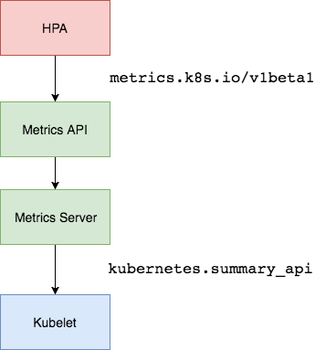
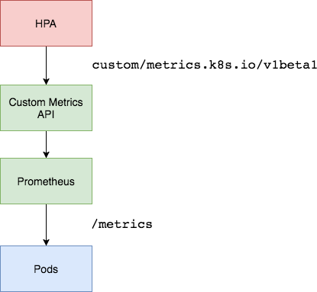
HPA

Slide 8
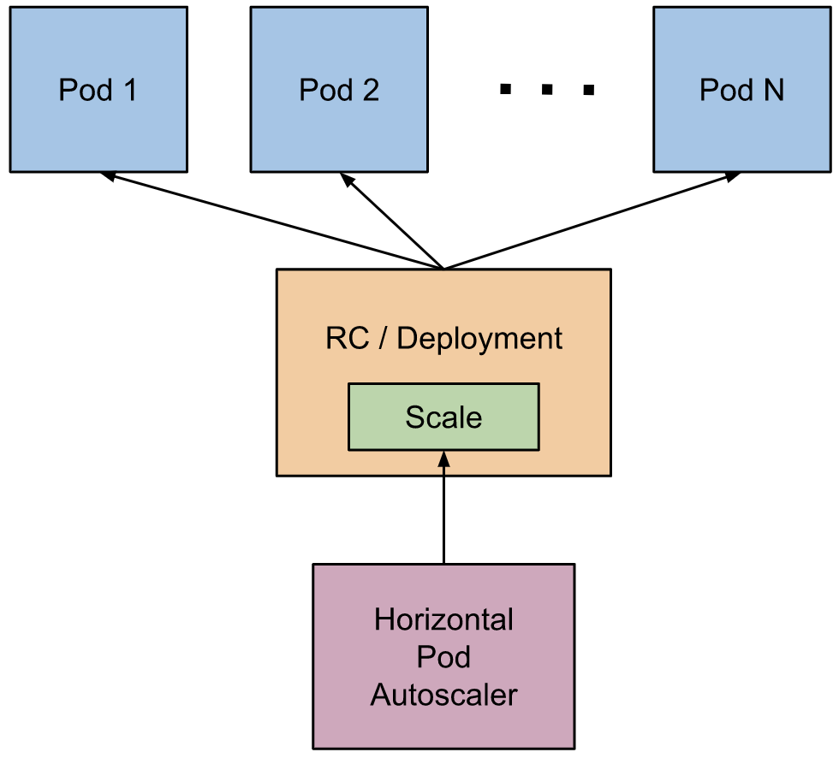
HPA

Slide 9
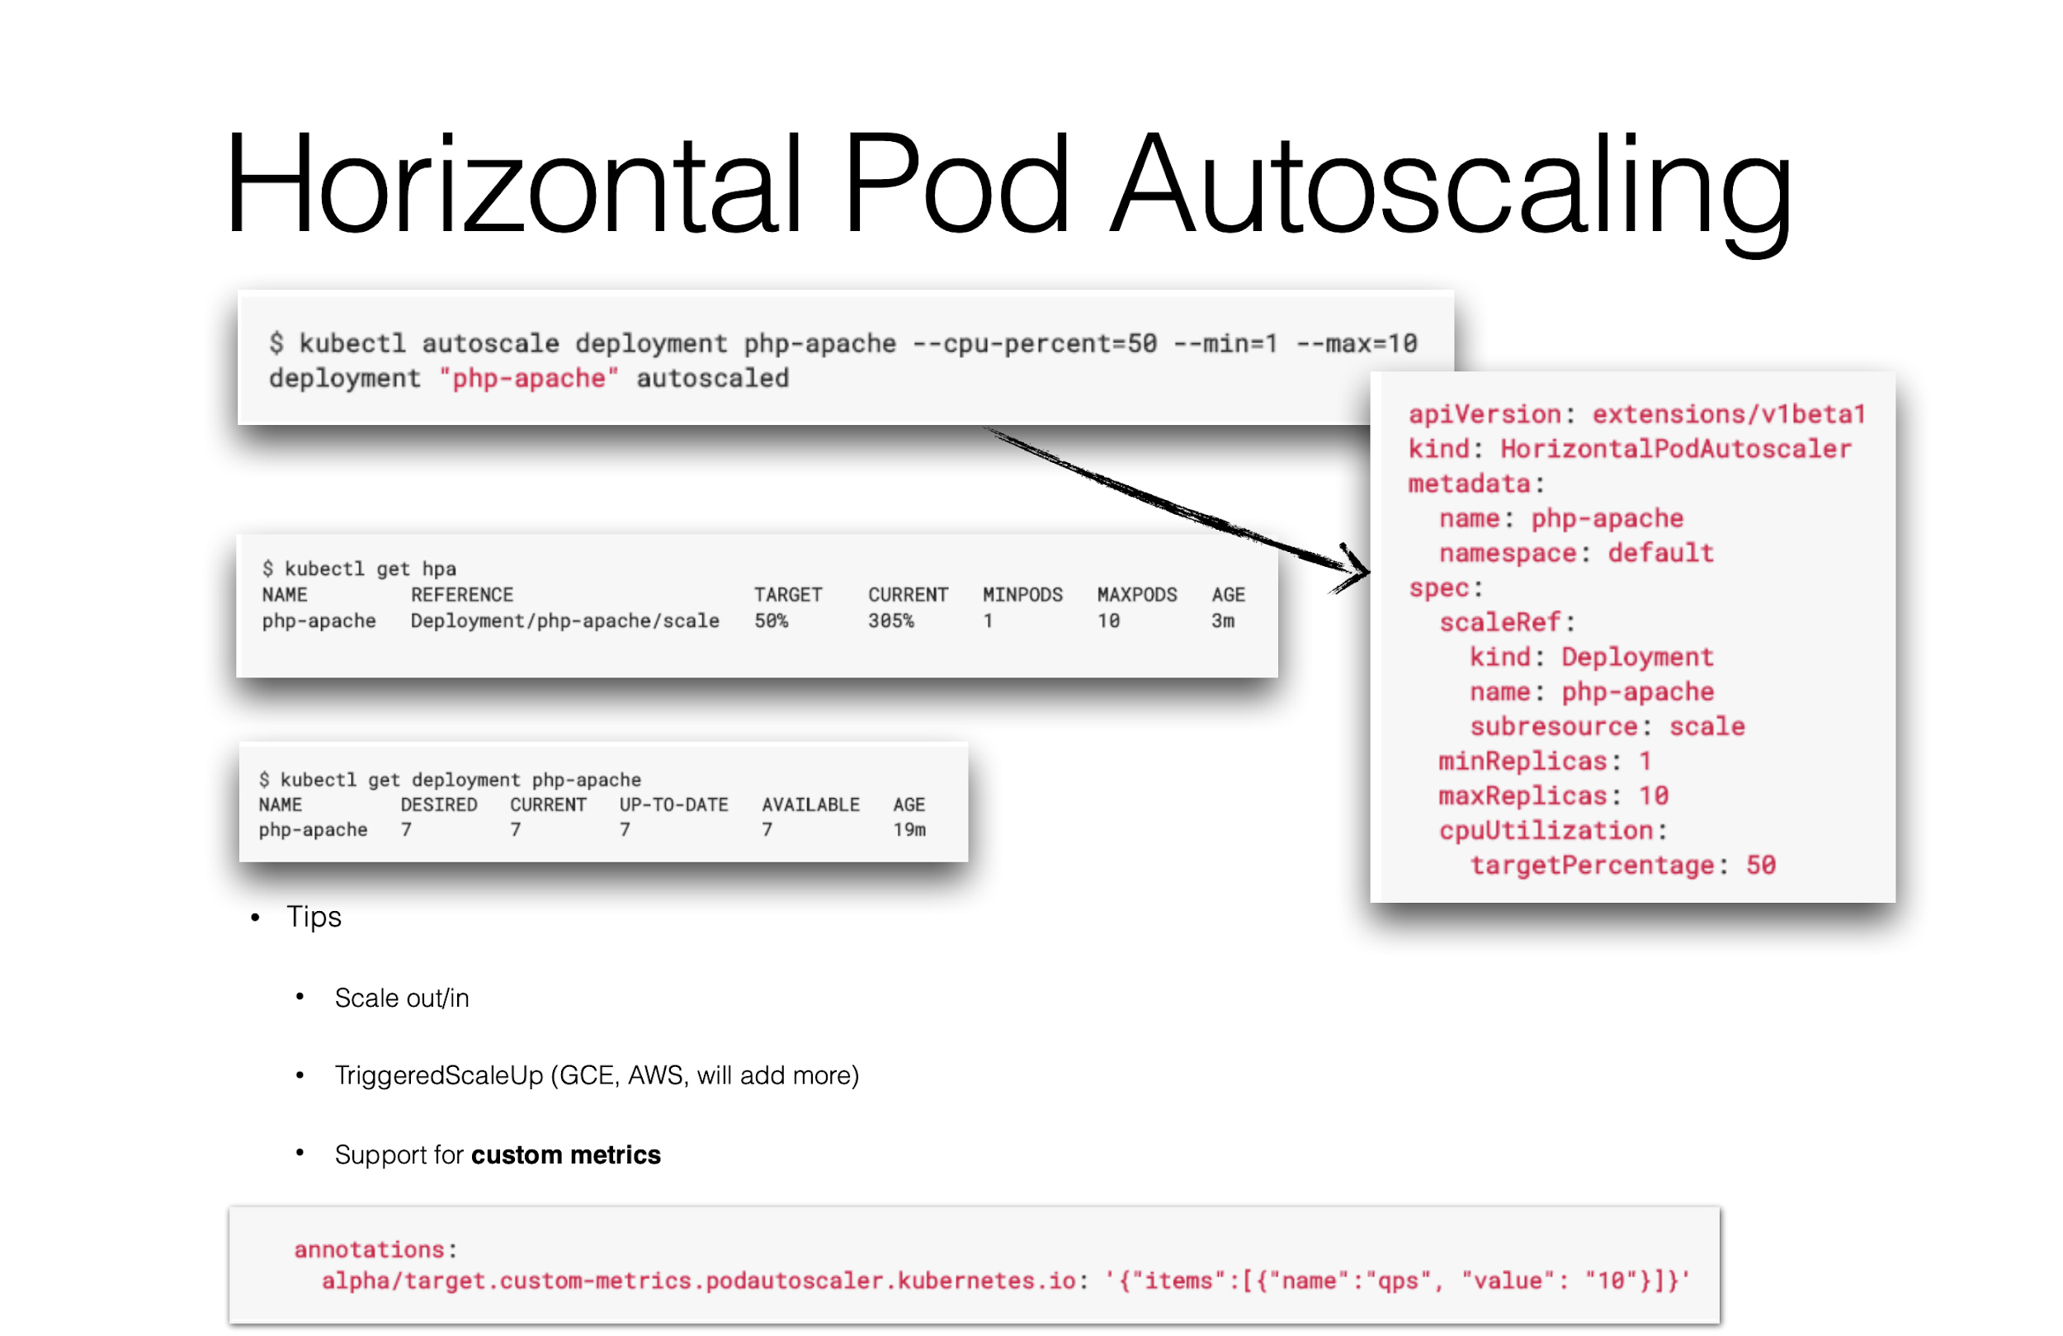

Slide 10
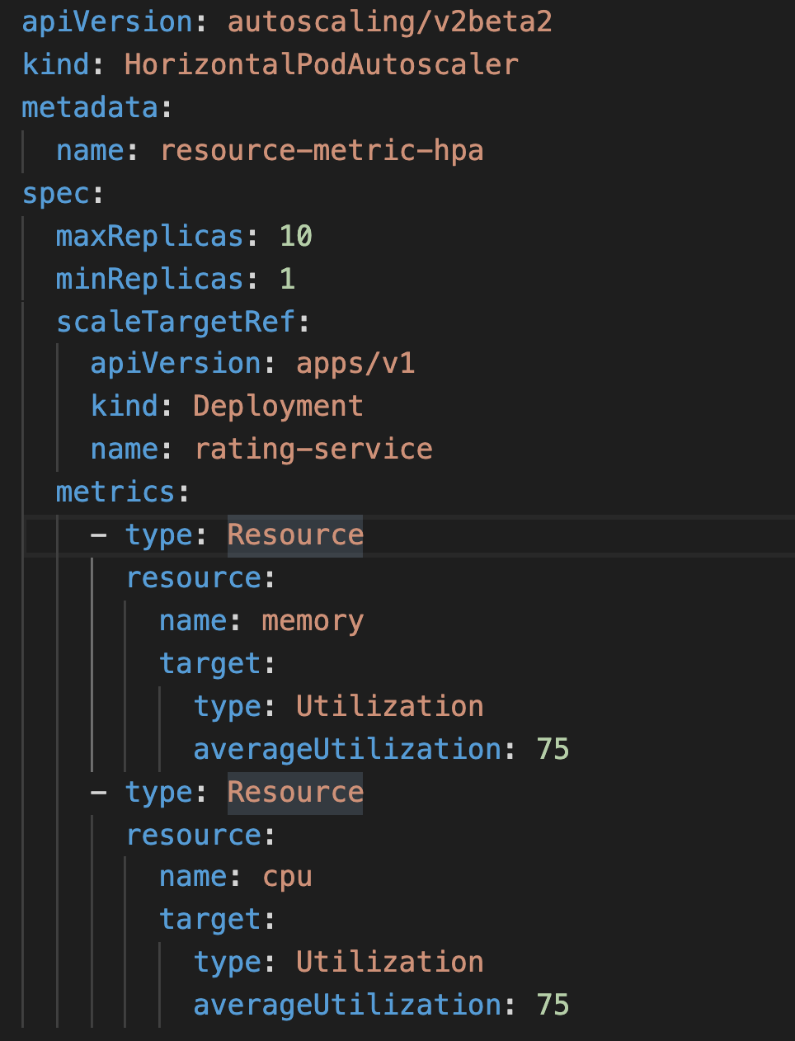
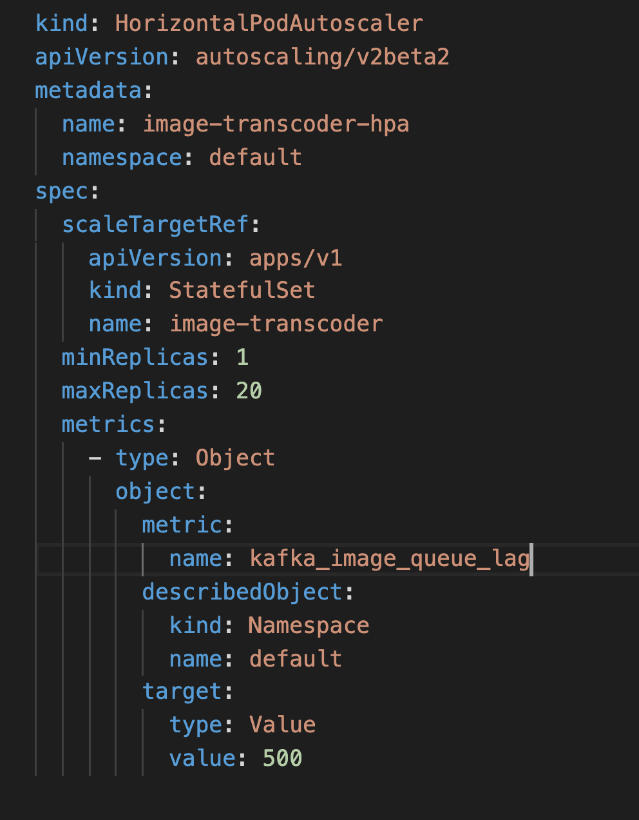
HPA

Slide 11
Cluster Autoscaler
Automatically increases or decreases the nodes in the cluster
Pods pending - insufficient resources,
Nodes underutilized for an extended period of time
Supported cloud providers:
GCE
GKE
AWS
Azure
Alibaba Cloud
DigitalOcean

Slide 12
Monitoring - Prometheus

Slide 13
Prometheus
Open-source monitoring and alerting toolkit originally built at SoundCloud
Time series collection happens via a pull model over HTTP
Targets are discovered via service discovery or static configuration
Multiple modes of graphing and dashboarding support

Slide 14
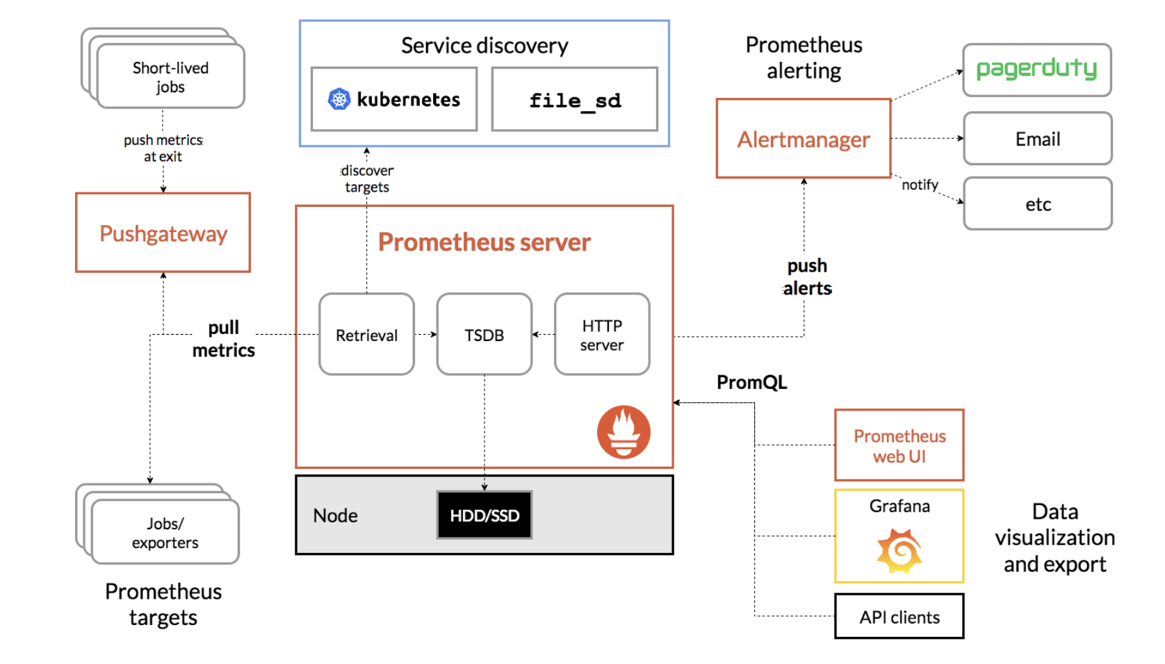

Slide 15
Logging - EFK Stack

Slide 16
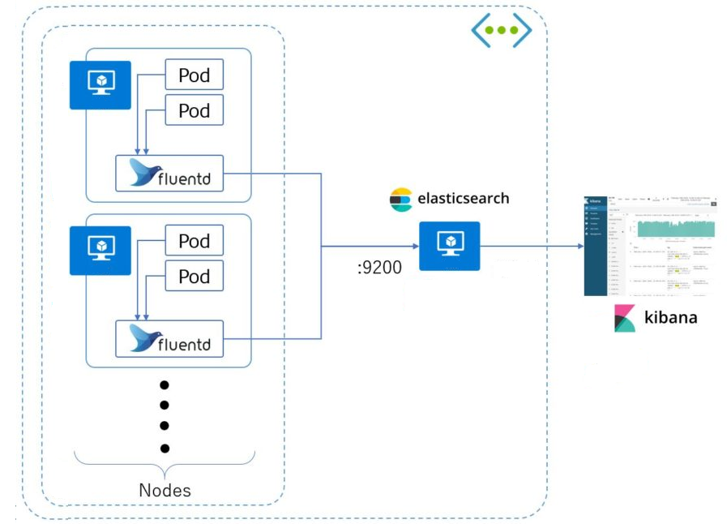

Slide 17
EFK Stack
Elasticsearch is a real-time, distributed, and scalable search engine which allows for full-text and structured search
Kibana is a powerful data visualization frontend and dashboard for Elasticsearch
Fluentd is a popular open-source data collector to tail container log files, filter and transform the log data

Slide 18

Thank You
youtube.com/KuppiyaSL

